Slide 1


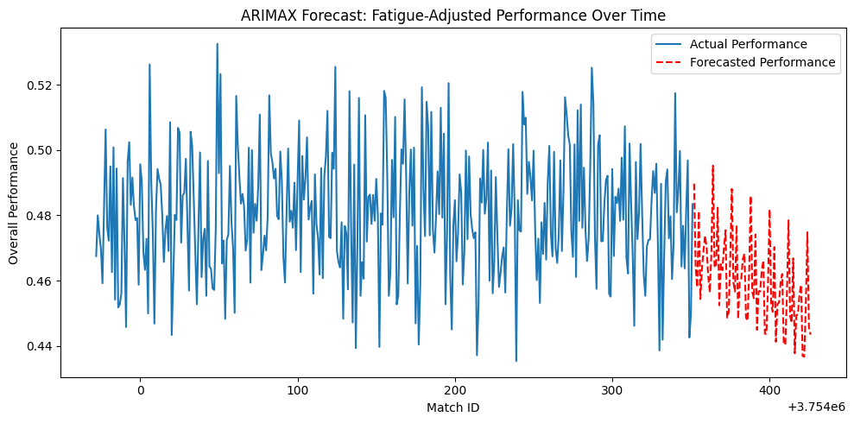
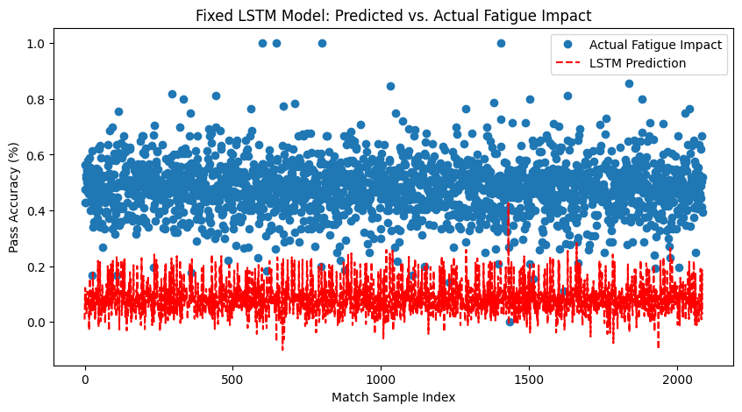
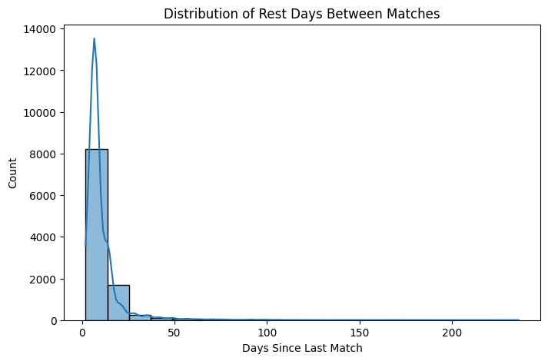
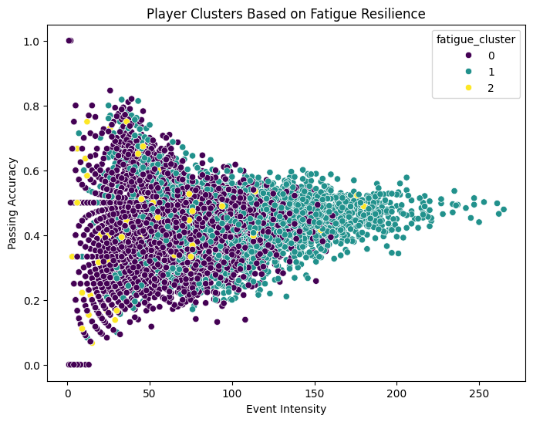

Quantifying the Impact of Fatigue on Player Performance in Soccer
Jacky Jiang
Rice University Department of Sports Management
Abstract
Methodology & Analysis
Results Continued
Fatigue is a critical yet complex factor affecting player performance in professional soccer. Traditional methods of fatigue assessment often rely on invasive biomarkers or subjective measures, which limit their scalability across an entire season. In this study, we propose a data-driven framework that leverages event-level soccer data to quantify fatigue and assess its impact on individual player performance. Using detailed match data from the 2019–20 La Liga season, we construct fatigue indicators such as days since last match, total games played, and event intensity, and examine their relationships with key performance metrics — pass accuracy, duel win rate, and shot success rate.
We evaluate multiple modeling approaches including linear regression, random forest, ARIMAX, and LSTM neural networks to predict performance under varying fatigue conditions. Our findings reveal that while historical performance is the strongest predictor of match outcomes, fatigue-related features — particularly match intensity — add measurable explanatory power. Clustering analysis further identifies distinct fatigue-resilience profiles among players. This study demonstrates the feasibility of using non-invasive, tracking-derived indicators to model fatigue, offering valuable insights for match planning, squad rotation, and player management in elite soccer contexts.
1. Linear Regression with Fatigue Features or include images of your data, the methodology.
$$y_{i}=β_{0}+β_{1}x_{hist}+β_{2}x_{fatigue1}+β_{3}x_{fatigue2}+β_{4}\left(x_{fatigue1}×x_{fatigue2}\right)+ε_{i}$$
Where:
$y_{i}$: Current performance metric (pass accuracy, duel win rate, or shot success rate)
$x_{hist}$: Historical performance metric
$x_{fatigue1}$: Days since last match
$x_{fatigue2}$: Total games played
$ε_{i}$: Model coefficients
2. K-Means Clustering for Fatigue Resilience
$$J=\sum_{i=1}^{k}{\sum_{x∈C_{i}}{|}x}−μ_{i}|^{2}$$
3. Random Forest Regression
$$\hat{y}=\frac{1}{T}\sum_{t=1}^{T}{f_{t}\left(x\right)}$$
4. ARIMAX Model (Time Series Forecasting)
$$y_{t}=c+\sum_{i=1}^{p}{φ_{i}y_{t−i}}+\sum_{j=1}^{q}{θ_{j}ε_{t−j}}+\sum_{k=1}^{r}{β_{k}x_{t}^{\left(k\right)}}+ε_{t}$$
5. Long Short-Term Memory (LSTM)
Cell State Update: $C_{t}=f_{t}⊙C_{t−1}+i_{t}⊙\tilde{C_{t}}$
Hidden State Update: $h_{t}=o_{t}⊙\backslash tanh\left(C_{t}\right)$
3. Random Forest Regression
By introducing fatigue indicators into the model, we observed:
R² increased from 0.120 to 0.191.
Event Intensity (total events) became the top fatigue predictor (20.6% importance), surpassing some historical metrics.
4. ARIMAX Model (Time Series Forecasting)
Significant negative effect from:
Total Events (β = -0.0007, p < 0.001)
Games Played (β = -0.0003, p = 0.023)
No significant effect from short-term rest (Days Since Last Match, p = 0.675)
4. LSTM
LSTM captured broad patterns but underfit variance in outcomes.
Error Metrics:
MAE = 0.399
MSE = 0.168
Introduction
Fatigue plays a crucial role in elite soccer, impacting players’ physical execution and decision-making. However, traditional fatigue measures—like biomarkers or minutes played—are invasive or lack the resolution to track performance across a full season.
This study leverages event-level data from the 2019–20 La Liga season to develop non-invasive fatigue indicators (e.g., days since last match, total games played, event intensity). We examine how these indicators relate to performance outcomes like pass accuracy, duel win rate, and shot success rate.
Using a combination of regression models, machine learning, and time-series forecasting, we explore both the predictive power of fatigue and identify players with differing fatigue resilience profiles—offering actionable insights for rotation and recovery planning.
Conclusion & Recommendations
Key Takeaways:
Fatigue has measurable, though subtle, effects—especially on physical actions.
Match intensity (not just rest days) strongly correlates with performance decline.
Integrating fatigue-aware modeling into team decision pipelines can enhance rotation and reduce injury risk.
Recommendations for Coaches/Analysts:
Monitor cumulative workload via total games and match events.
Identify fatigue-resilient players for congested schedules.
Use models like Random Forest for practical performance forecasting.
Results
1. Linear Regression
2. K-Means Clustering
Metric | Model | R²
Duel Win Rate | Baseline | 0.123
 | Extended | 0.176
Shot Success Rate | Baseline | 0.047
 | Extended | 0.061
References
[1] M. Mohr et al., J. Sports Sci., 2005. [2] C. Carling et al., Sports Med., 2012. [3] D. Link and M. Hoernig, PLoS ONE, 2016. [4] R. Torres et al., Int. J. Perf. Anal. Sport, 2020. [5] S. Hochreiter and J. Schmidhuber, Neural Comput., 1997.

